Slide 1
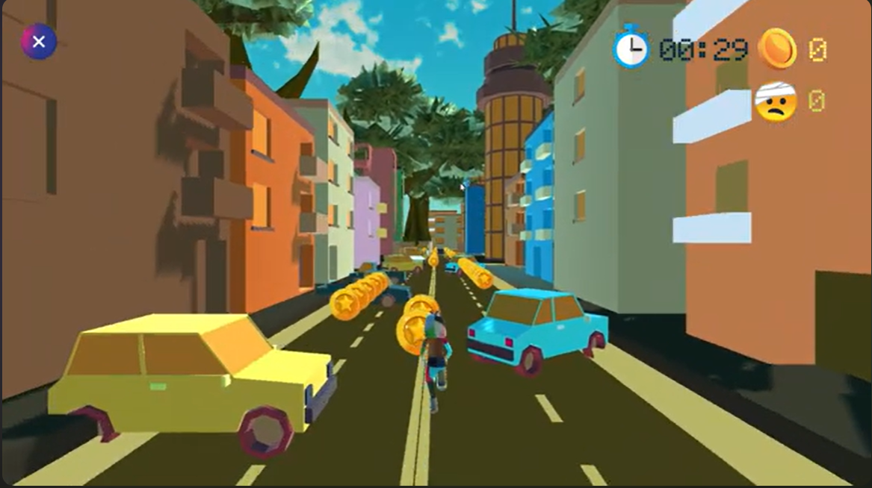

Vapor Drift
Presented by Group No:05
Name: Tashfiq Mahmud Niloy(2221080642)
Name: Ihtishamul Haq Shimanto(2221838642)
Name: Tirana Akter Meem(2211659042)
Name: Tamanna Akter Mou(2211951042)

Slide 2
Problem Statement
The Challenge
Despite the massive popularity of the endless runner genre, many existing mobile and PC titles often suffer from a lack of engaging, high-fidelity environments, overly complex monetization schemes, or a feeling of repetitiveness.
The Opportunity
There is a demand for a simple, visually distinct (low-poly 3D urban aesthetic), and skill-based endless runner that offers a clean, non-intrusive gameplay experience, focusing on pure challenge and player mastery.

Slide 3
Game Concept Overview
Game Title: Vapor Drift
Genre: Endless Runner
Platform: PC
Core Loop: The player controls a character running through a dynamic, traffic-filled urban environment, collecting coins and dodging obstacles (cars). The game is designed for quick, highly replayable sessions focused on achieving a high score or level objective.
Visual Style: Low-poly 3D graphics with a bright, stylized urban aesthetic, giving it a distinctive look.

Slide 4
Gameplay Visuals
In-Game Action
The core screen shows the runner in the middle of a multi-lane road, surrounded by traffic and collecting trails of coins.
Visuals: The low-poly cars (yellow and blue) and buildings create a unique, stylized urban environment.
Key HUD Elements
Timer: Located at the top right, critical for "Timer Levels".
Coin Counter: Shows collected coins, tied directly to the win condition.
Health Indicator: Represented by the sad, bandaged face icon, showing the player has a limited number of "bumps" before losing.
Pause Screen
Shows the options to Resume, Restart, and Quit, along with an adjustable Sensitivity slider , indicating a focus on player control and accessibility.

Slide 5
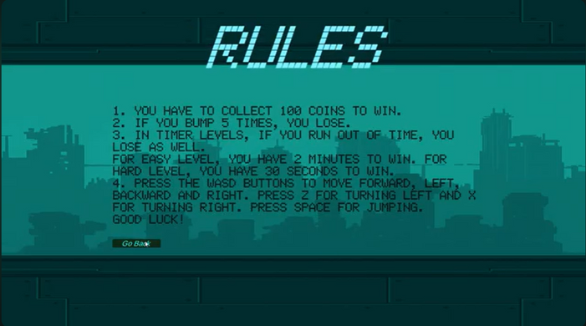
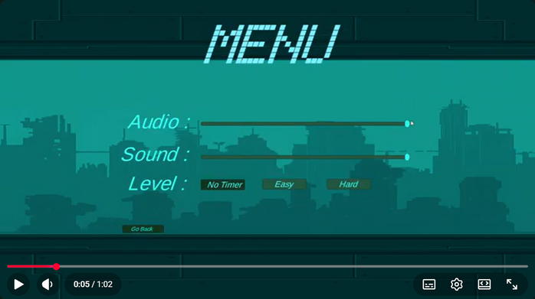
Core Features
Customizable Difficulty & Gameplay Modes
Clear Ruleset
No Timer: Pure endless mode, focused only on coin collection and survival.
Easy Level: Win condition is 100 coins within 2 minutes.
Hard Level: Win condition is 100 coins within 30 seconds (high skill ceiling).
Simple and easy to understand from the start.
Collect 100 Coins to Win.
Bump 5 Times, You Lose.
Run out of time in Timer Levels, You Lose.
Responsive Controls
Player Control
The game supports granular movement and actions:
WASD: Forward, Left, Backward, Right.
Z/X: Turning Left/Right.
SPACE: Jumping.
Adjustable Audio, Sound, and Gameplay Sensitivity settings available in the Menu.

Slide 6
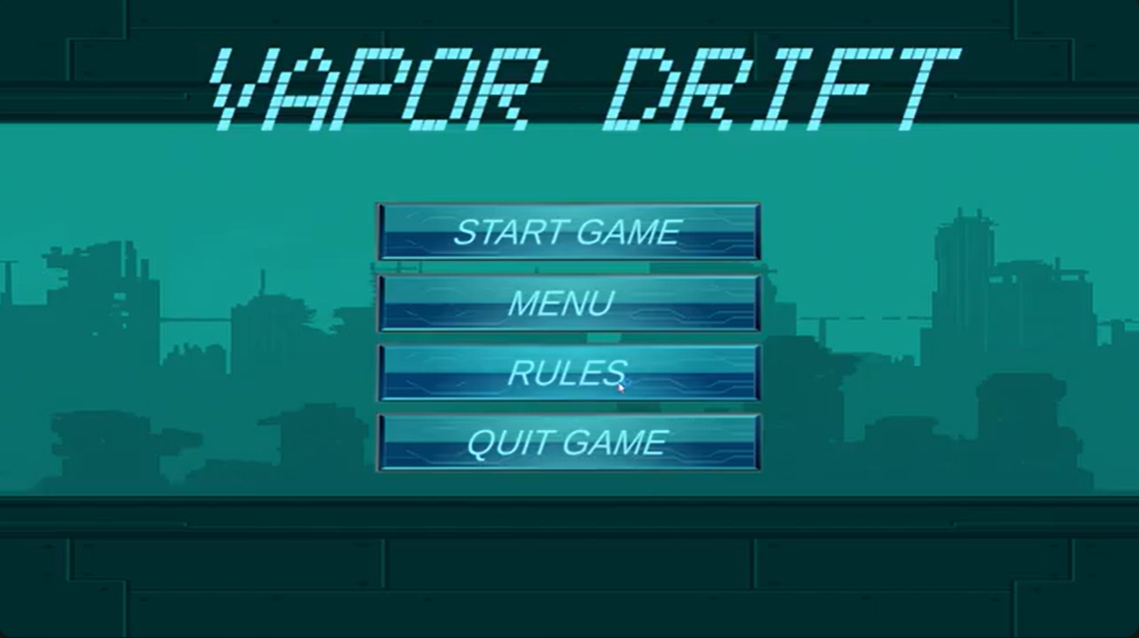
Target Audience
Casual Gamers
Individuals looking for a quick, fun, and accessible game to play during short breaks. The simple controls and clear objectives appeal to this group.
Skill-Based Gamers
Players who enjoy mastering controls, optimizing routes, and competing for the fastest clear times on the "Hard Level."
Fans of Stylized Aesthetics
The low-poly, vibrant urban visual style will attract players looking for games with unique and appealing art direction.

Slide 7
Market Analysis Overview
Platform Focus: Steam
Community Building: Utilize platforms like YouTube and Twitch to showcase high-score runs and highlight the fast-paced gameplay and different difficulty settings.
Launch Strategy: Focus on an initial launch emphasizing the "Pure Gameplay, No Ads" philosophy, which serves as a powerful differentiator in the crowded market.
PR/Influencers: Target smaller, genre-specific content creators who review endless runner and arcade titles to get authentic early exposure.

Slide 8
Monetization Strategies Unveiled
Premium Focus
The primary source of early revenue will come from the initial purchase/download of the game.
In-Game Purchases
Cosmetic Skins: A non-intrusive revenue stream based on aesthetics only. Purchasable in-game character skins will drive profit without giving players a competitive advantage .

Slide 9
Funding for Success
Current State
The core game concept, visuals, and mechanics are complete.
Use of Funds
Platform Fees: Covering store submission and developer fees.
Content Expansion: Developing new environments, cars, obstacles, and cosmetic skins post-launch to sustain interest.

Slide 10
Any questions for us?

